Slide 1
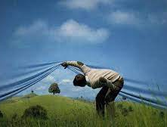
The Myth
Of “Happily Ever After”

Slide 2
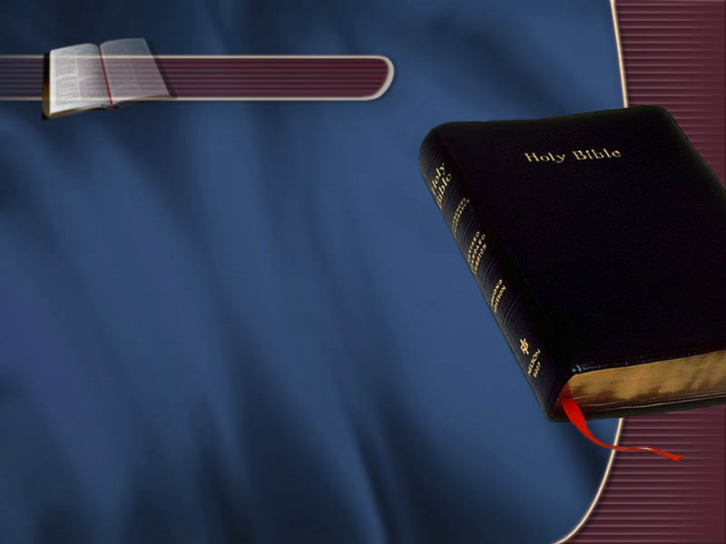
Key Text
1 Corinthians
7:28
Notes:
Proverbs 5:18 May your fountain be blessed, and may you rejoice in the wife of your youth.

Slide 3
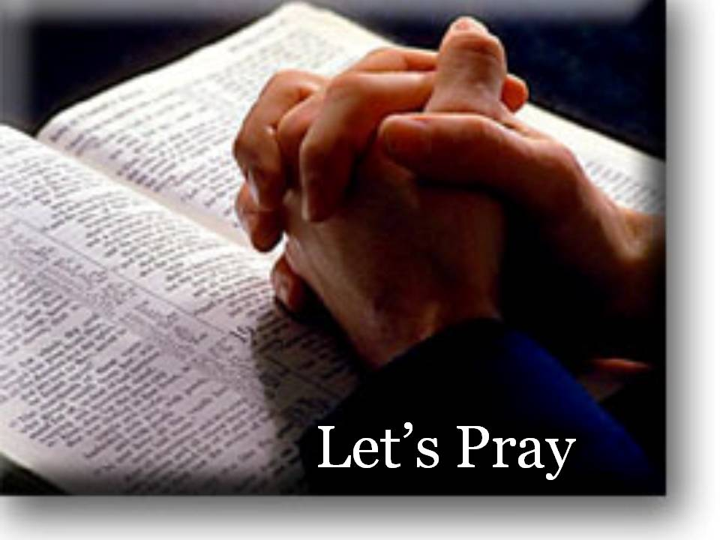

Slide 4
1 Cor. 7:28
²⁸ But if you do marry, you have not sinned; and if a virgin marries, she has not sinned. But those who marry will face many troubles in this life, and I want to spare you this.
Notes:
Proverbs 5:18 May your fountain be blessed, and may you rejoice in the wife of your youth.

Slide 5
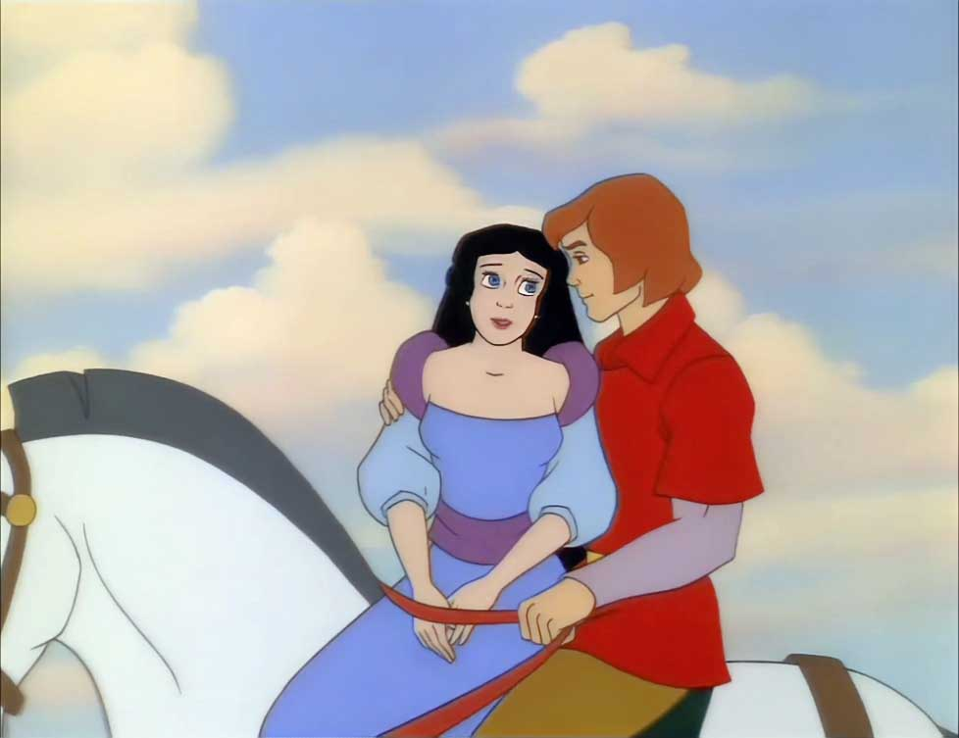
And they lived
Happily ever after…

Slide 6


Slide 7

“Happily Ever after”
"Happily ever after" is a traditional, formulaic phrase used to conclude fairy tales, children's stories, and romantic narratives, signaling a permanent state of joy, contentment, and safety for characters following the resolution of major conflicts.
It represents an idealized, "trouble-free" future, often implying lifelong, unwavering happiness lasting until "death do you part".

Slide 8

We all expect “happily ever after”
A love that never dies
A life without loneliness
A conflict-free marriage
A spouse who doesn’t worry me
A spouse who understands me
Constant happiness
Sustained romance
Exciting sex

Slide 9


Slide 10

HOWEVER
The reality of marriage shows that the thought of living “happily ever after” could be a myth
WHY?

Slide 11
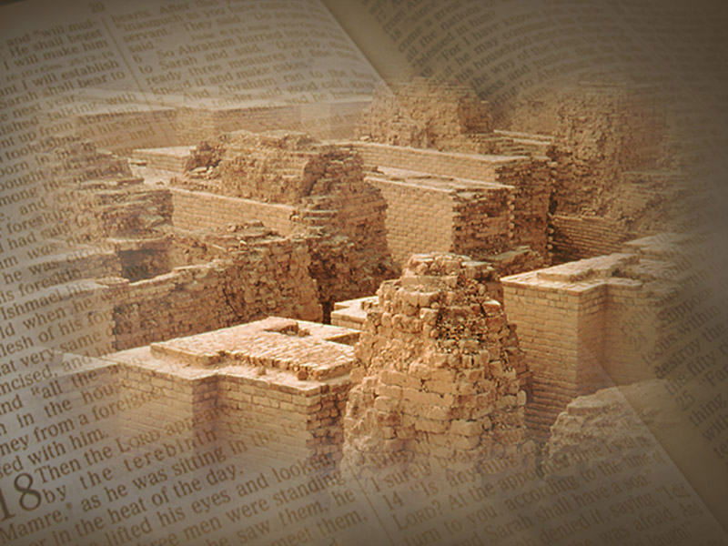
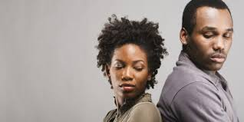
The story of Marriages today

Slide 12


Slide 13
People’s realities…
Disillusionment due to unmet expectations
Realization of Character traits hitherto unknown
Conflict/power struggle
Work and life pressure
Changes due to normal “wear and tear” in marriage (beauty, strength, kids, etc)
Marriage for the sake of being married.

Slide 14
1 Cor. 7:28
²⁸ But if you do marry, you have not sinned; and if a virgin marries, she has not sinned. But those who marry will face many troubles in this life, and I want to spare you this.
Notes:
Proverbs 5:18 May your fountain be blessed, and may you rejoice in the wife of your youth.

Slide 15
There are STAGES in every marriage. Different Scholars propound different Stages:
Most Popular:
The Romance Stage
The Disillusionment stage
The Power Struggle stage
The Stability stage
The Commitment stage

Slide 16
Retrouvaile (4 Stages):
Romance
Disillusionment
Misery
Awakening

Slide 17
DeMaria and Harar (7 Stages)
Passion
Realization
Rebellion
Cooperation
Reunion
Explosion
Completion

Slide 18
Larson (3 Stages):
Romance Love
Disillusionment and distraction
Dissolution, adjustment and resignation OR Adjustment and Contentment

Slide 19
My Adaptation
Honeymoon stage
Reality stage
Conflict stage
Response to Conflict
Commitment/Dissolution

Slide 20
What Happens after the honeymoon is your reality:
Your reaction/Response determines your “happily ever after” or otherwise:
  Tolerance
  Compromise
  Acceptance

Slide 21
Can we live
Happily ever after?

Slide 22
Keep in mind:
“Happily ever after” can be possible if we do the following:
Understand that not all expectations will be met
Be ready to encounter character traits you didn’t know existed
Have a good conflict resolution strategy
Build effective communication skills

Slide 23

Questions
Comments
Thoughts

